Slide 1
Friend Recommendation System using Ensemble Voting
Dhariya Parikh
Yashwanth Varre
Viswanathan Appakkudal Ramani

Slide 2
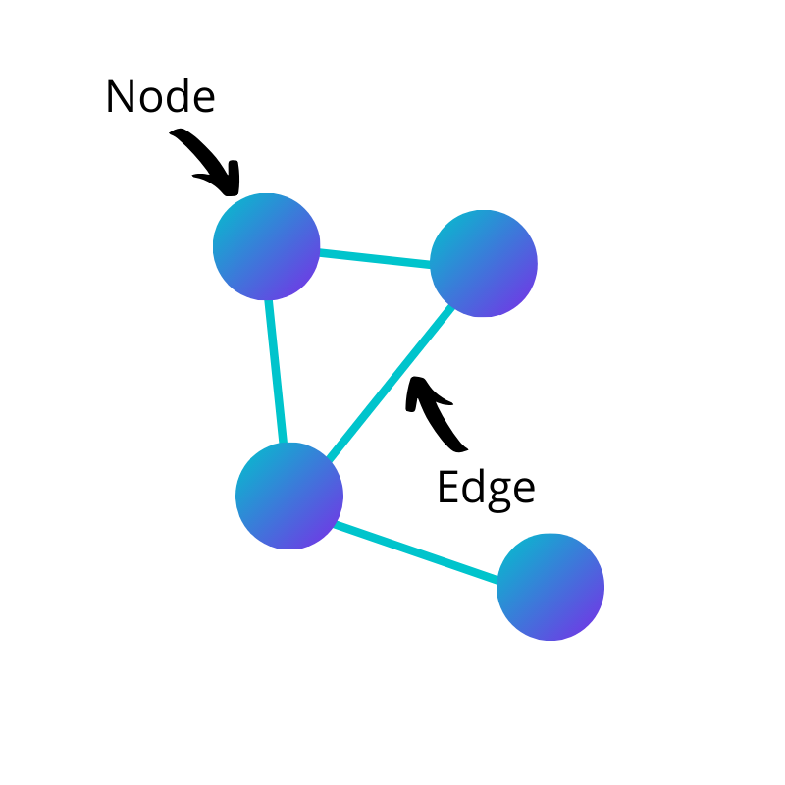
Objective
Given two users who are not friends on social media, predict whether or not the two users would become friends in the future.
Three persons P1, P2, P3 form a length-3 following chain if a person P1 follows person P2, and person P2 follows P3. Given a length-3 following chain, it may make sense to recommend to P1 to follow person P3.
Source: https://towardsdatascience.com/how-to-get-started-with-social-network-analysis-6d527685d374

Slide 3
Data
Data Resource: https://snap.stanford.edu/data/
Dataset: Facebook dataset
About the data:
The Facebook dataset contains 4039 users and 88,234 friend connections distributed among the 4039 users
Number of triangles is 1612010
File size: 1MB

Slide 4
Steps
Load the datasheet.
Extract features from the given data. Jaccardian, Adam index, Common Neighbours, Resource Allocation, and Preferential Attachments are the features extracted from the data.
Eliminate nodes which don’t have any connection
Split train/test set
Perform Machine Learning to get accuracy score
Tune the model to enhance the accuracy

Slide 5
Features
Lests assume A,B to be two members, and their friends are represented as sets.
A= {1,2,3,4,5} B = {4, 5, 6, 7}
Jaccard similarity index compares members for two sets to see which members are shared and which are distinct.
J(A, B) = UNION(A,B) = UNION(A,B)/ INTERSECTION(A,B)
J(A,B) = 2/7
Common Neighbors: Number of mutual friends between two individuals
CN(A,B) = UNION(A,B)
CN(A,B) = 2

Slide 6
Features
Resource Allocation Index is measure that calculates amount of resource that a node can send to destination node via its neighbors
RA(A,B) = ψ (x ∈ CN(A,B)) ∑ (1 / CN(x))
Preferential Attachment: More number of mutual friends, more influential the person is
PA(A,B) = CN(A) * CN(B)
PA(A,B) = 5*4 = 20
Adamic Adar Index: Higher the value, if amount of shared links between two nodes are higher
RA(A,B) = ψ (x ∈ CN(A,B)) ∑ (1 / log|CN(x)|)

Slide 7
Algorithm
Ensemble of :
ANN
Logistic
Naïve Bayes
SVM, Decision Tree, Random Forest (Considered but not used)
Weighted Voting Strategy:
Find the classifier with maximum accuracy and provide maximum weight for this classifier
Eliminate classifiers that overfit/undefit
Vote other classifiers relatively based on their accuracy
Eliminate classifiers whose accuracy is less than the threshold

Slide 8
Weighted Voting – Approach Illustration
 | ANN | Naïve Bayes | SVM | Logistic | Decision Tree | Random Forest | KNN
Test Accuracy | 67.3 | 69.5 | 32.6 | 69.9 | 46.1 | 44.2 | 51.5
Train Accuracy | 66.4 | 65.6 | 65.8 | 65.9 | 79.7 | 79.7 | 72.2
Votes | 4 | 5 | 0 | 5 | 0 | 0 | 0
SVM, KNN, Decision Tree, Random Forest – Overfitting. Hence, Eliminated
Logistic has the highest Accuracy (69.9%).
Assumed Variance = 2% . Relative Voting,
68% - 70% = 5 points
66% - 68% = 4 points
64% - 66% = 3 points
62% - 64% = 2 points
60% - 62% = 1 point
<60% = Elimination

Slide 9
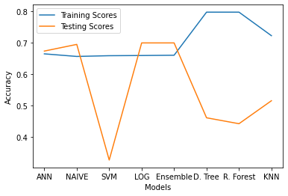
Results
Ensemble of Weighted Voting Model:
Training Accuracy: 66%
Testing Accuracy: 69.9%

Slide 10
References
J. McAuley and J. Leskovec. Learning to Discover Social Circles in Ego Networks. NIPS, 2012.
Ali Choumane, Zein Al Abidin Ibrahim. Friend Recommendation based on Hashtags Analysis
Qi Yang, Aleksandr Farseev, Andey Filchenkov I Know Where You Are Coming From: On the Impact of Social Media Sources on AI Model Performance
Marzieh Pourhojjati-Sabet, Azam Rabiee. A Soft Recommender System for Social Networks
J. Chen, W. Geyer, C. Dugan, M. Muller, and I. Guy, “Make new friends, but keep the old: recommending people on social networking sites,” in Proceedings of the 27th international conference on Human factors in computing systems, ser. CHI ’09. New York, NY, USA: ACM, 2009, pp. 201–210. [Online]. Available: http://doi.acm.org/10.1145/1518701.1518735

Slide 11
References
Fire, M., Tenenboim, L., Lesser, O., Puzis, R., Rokach, L., Elovici, Y.: Link Prediction in Social Networks using Computationally Efficient Topological Features. In: Privacy, security, risk and trust (passat), 2011 ieee third international conference on and 2011 ieee third international conference on social computing (socialcom), pp. 73–80. IEEE (2011)
Noble, W. What is a support vector machine?. Nat Biotechnol 24, 1565–1567 (2006). https://doi.org/10.1038/nbt1206-1565
Garson, D. (2008). Logistic regression. Retrieved December 3, 2008, from http://faculty.chass.ncsu.edu/garson/PA765/logistic.htm.

